Slide 1
Building an Intelligent Chatbot With Microsoft Bot Framework and Conversational Language Understanding
Philip Okoth
December 2025
Open Classroom
Notes:
AI-generated content may be incorrect. --- This presentation covers the creation of intelligent chatbots using Microsoft BotFramework combined with Conversational Language Understanding (CLU). We will explore chatbot fundamentals, development tools, integration of language models, conversation design, and deployment strategies.

Slide 2
Project Framework
Introduction to Chatbots and Conversational AI
Getting Started with Microsoft BotFramework
Integrating Conversational Language Understanding Model
Designing Effective Bot Conversations
Testing, Deployment, and Monitoring
Notes:
We will begin with an introduction to chatbots and conversational AI, discuss getting started with Microsoft BotFramework, explore integrating CLU models, learn best practices for designing effective bot conversations, and conclude with testing, deployment, and monitoring techniques.

Slide 3
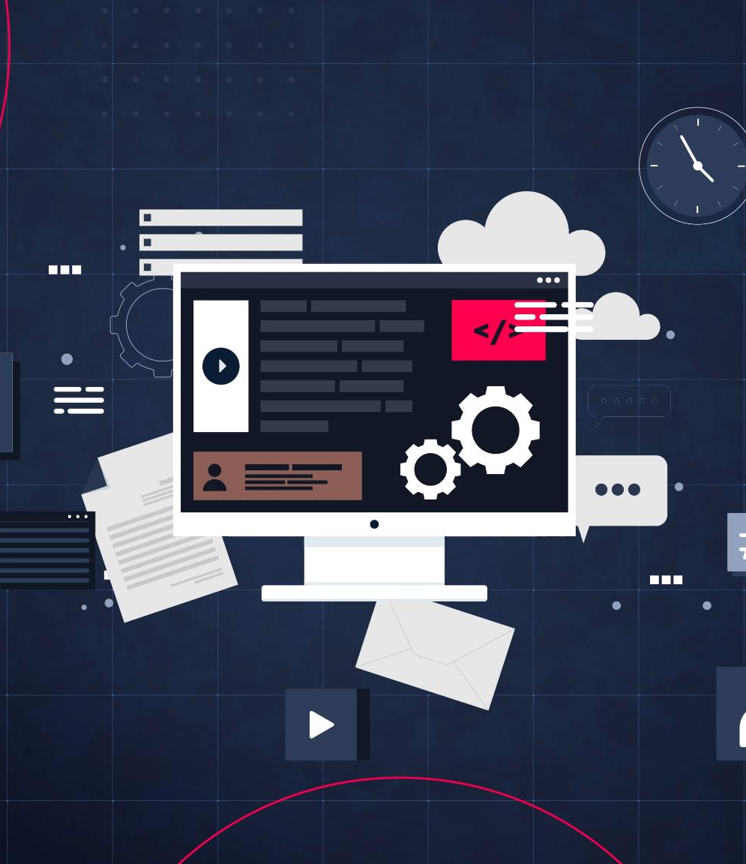
Introduction to Chatbots and Conversational AI
Notes:
Understanding the basics of chatbots and conversational AI is essential. This section covers chatbot definitions, their types, benefits of conversational AI, and the typical lifecycle involved in chatbot development.

Slide 4
Definition and Types of Chatbots
Types of Chatbots
Benefits of Conversational AI
Chatbot Definition:
Chatbots are software applications that simulate human conversation for interactive communication.
Types of Chatbots:
Rule-based chatbots follow predefined rules, while AI-powered chatbots use machine learning for responses.
Chatbot Applications:
Chatbots serve various purposes including customer support and assisting as personal digital helpers.
Enhanced User Engagement:
Conversational AI delivers personalized, natural interactions that boost user engagement and satisfaction.
Improved Operational Efficiency:
Automating tasks with AI reduces manual work and speeds up processes, improving efficiency.
24/7 Customer Support:
Conversational AI offers round-the-clock support ensuring users get help anytime they need it.
Notes:
--- Chatbots are software applications designed to simulate human conversation. They can be rule-based or AI-powered, serving purposes from customer support to personal assistants. Image source: Microsoft 365 content library

Slide 5
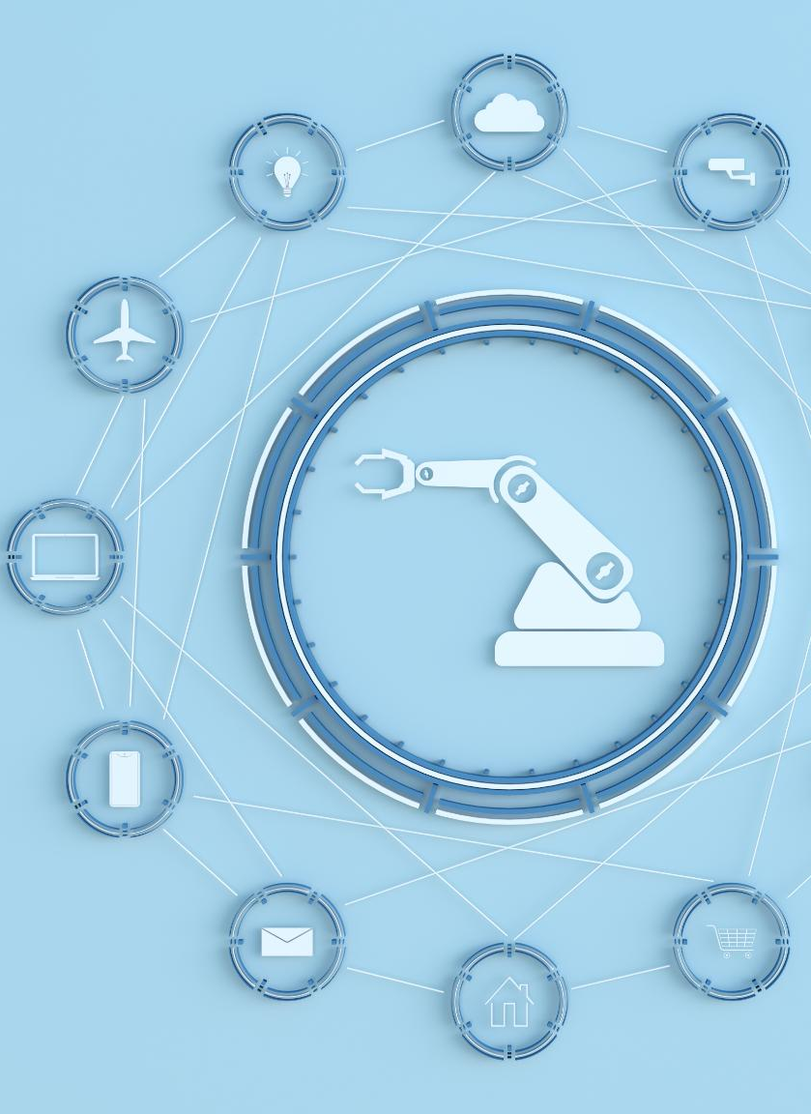
Overview of the Chatbot Development Lifecycle
Planning Phase
Identify chatbot goals, target audience, and required functionalities before development begins.
Design and Build
Create chatbot architecture and develop conversational flows to build an interactive user experience.
Testing and Deployment
Thoroughly test chatbot performance and deploy on platforms ensuring smooth operation.
Monitoring and Improvement
Continuously monitor chatbot usage and feedback to make iterative enhancements and improve user satisfaction.
Notes:
--- The development lifecycle includes planning, designing, building, testing, deploying, and monitoring the chatbot to ensure continuous improvement and user satisfaction. Image source: Microsoft 365 content library

Slide 6
Getting Started with Microsoft BotFramework
Notes:
Microsoft BotFramework provides a comprehensive platform for building and connecting intelligent bots. This section discusses its key features, environment setup, and creating a basic bot project.

Slide 7
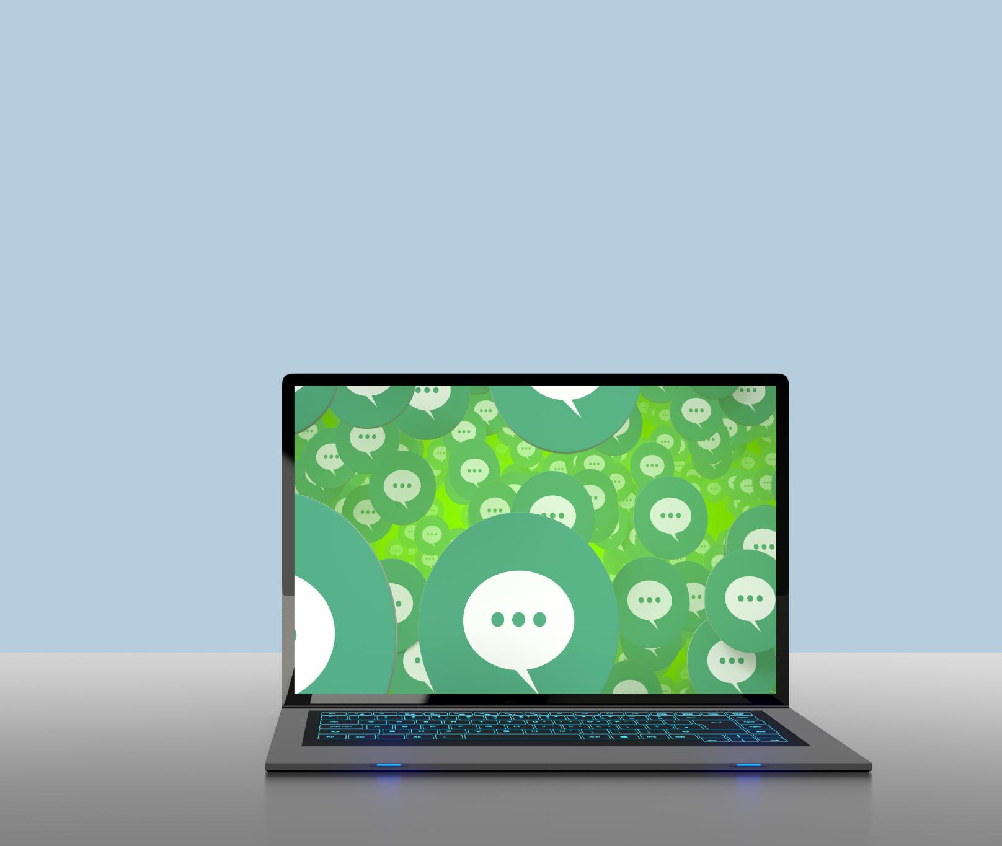
Key Features of BotFramework
Multi-Channel Support
BotFramework supports deployment across multiple communication channels for broad user reach.
Integration Capabilities
The framework integrates seamlessly with diverse services and APIs to enhance chatbot functionality.
Dialog Management Tools
Includes tools and SDKs that simplify creation and management of conversational dialogs.
Scalable Architecture
Designed to scale efficiently, supporting robust chatbot deployment for varied workloads.
Notes:
--- BotFramework offers multi-channel support, integration capabilities, SDKs, tools for dialog management, and scalable architecture for building robust chatbots. Image source: Microsoft 365 content library

Slide 8

Building a Basic Bot Project
Project Initialization
Start by setting up the project environment to build a basic bot structure efficiently.
Coding Basic Dialogs
Develop simple dialogs that enable the bot to interact and respond to users effectively.
Local Testing
Test the bot locally to ensure dialogs work properly and fix any issues before deployment.
Deployment Preparation
Prepare the bot for deployment by finalizing code and configuring deployment settings.
Notes:
--- Creating a simple bot includes initializing the project, coding basic dialogs, testing locally, and preparing it for deployment. Image source: Microsoft 365 content library

Slide 9
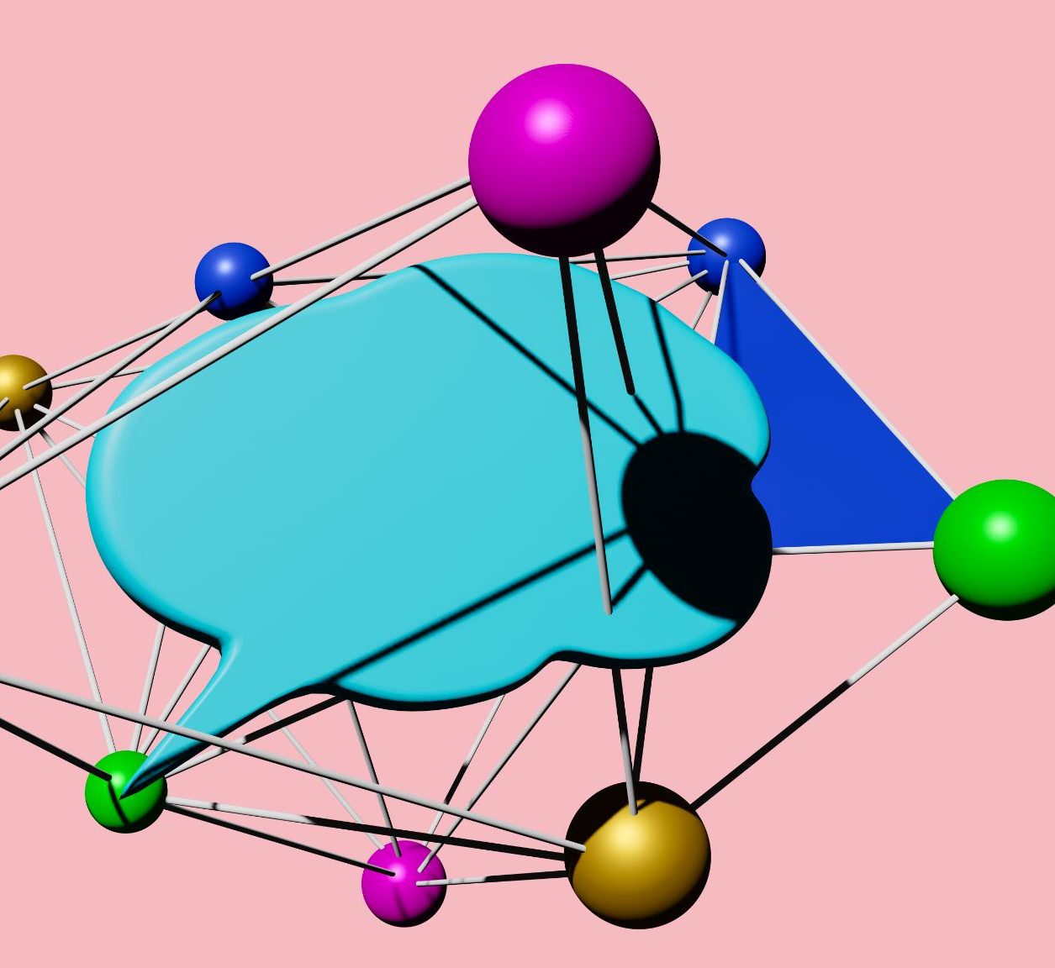
Introduction to Conversational Language Understanding (CLU)
Machine Learning Interpretation
CLU employs machine learning to analyze and understand human language inputs effectively.
Intent Identification
CLU identifies user intents to understand the purpose behind language inputs accurately.
Entity Extraction
CLU extracts relevant entities from language to capture critical information within conversations.
Notes:
--- CLU uses machine learning to interpret natural language inputs, identify intents, and extract entities to facilitate meaningful conversations. Image source: Microsoft 365 content library

Slide 10

Training and Deploying CLU Models
Preparing Labeled Data
Training starts with preparing accurately labeled data sets for effective model learning and performance.
Configuring Intents and Entities
Defining intents and entities is essential for the model to understand user requests and extract relevant information.
Cloud Deployment
Deploying trained models to cloud environments enables real-time processing and accessibility across platforms.
Notes:
--- Training involves preparing labeled data sets, configuring intents and entities, and deploying models to cloud environments for real-time use. Image source: Microsoft 365 content library

Slide 11
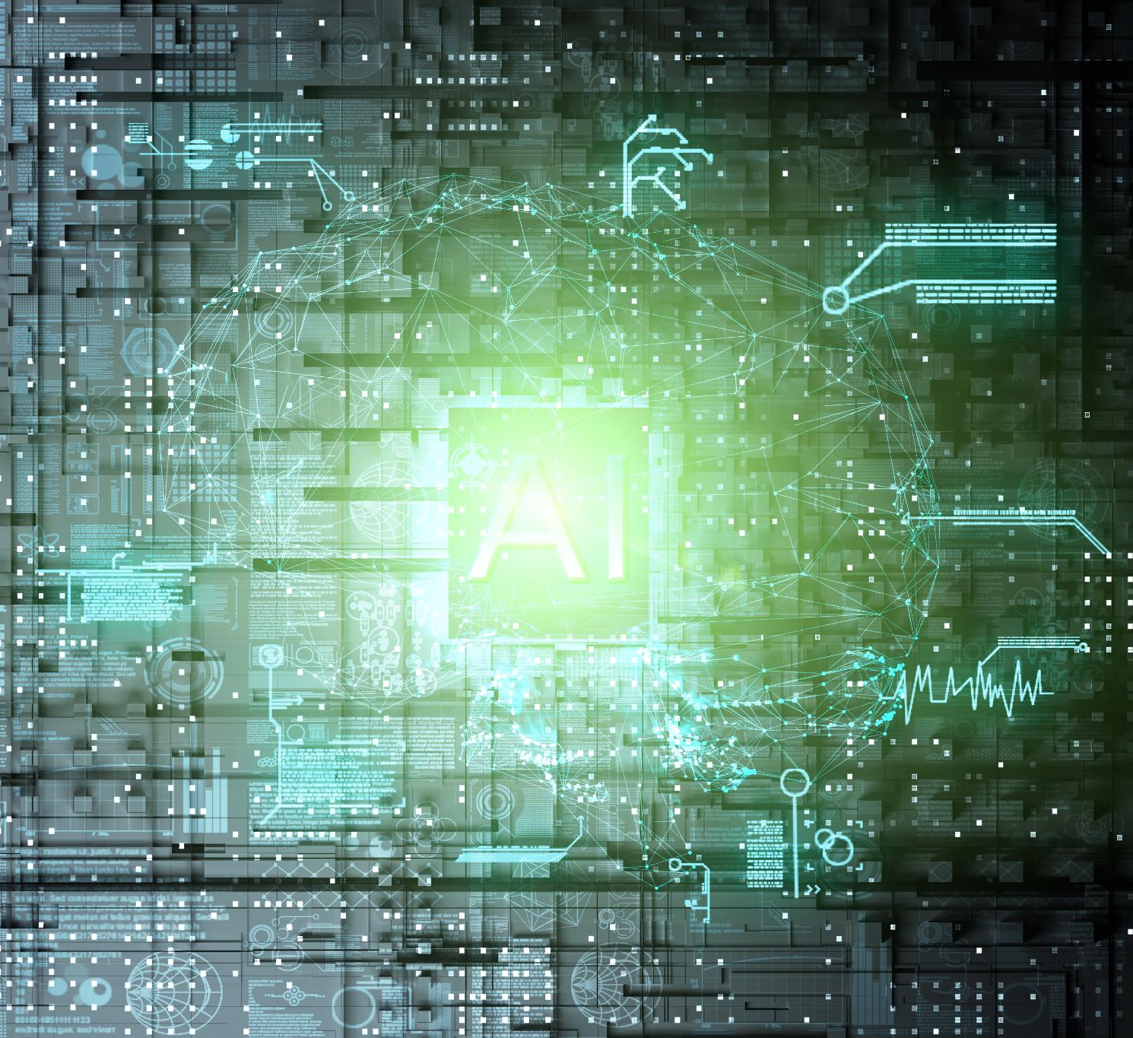
Connecting CLU with BotFramework
Leverage CLU Capabilities
Bots use CLU to enhance language understanding for accurate intent recognition and response.
API Connection
Connecting CLU APIs enables seamless communication and integration within bot dialogs.
Seamless Intent Recognition
Integration supports smooth and accurate intent recognition, improving dialog flow in bots.
Notes:
--- Integration allows the bot to leverage CLU's understanding capabilities by connecting APIs and enabling seamless intent recognition within dialogs. Image source: Microsoft 365 content library

Slide 12
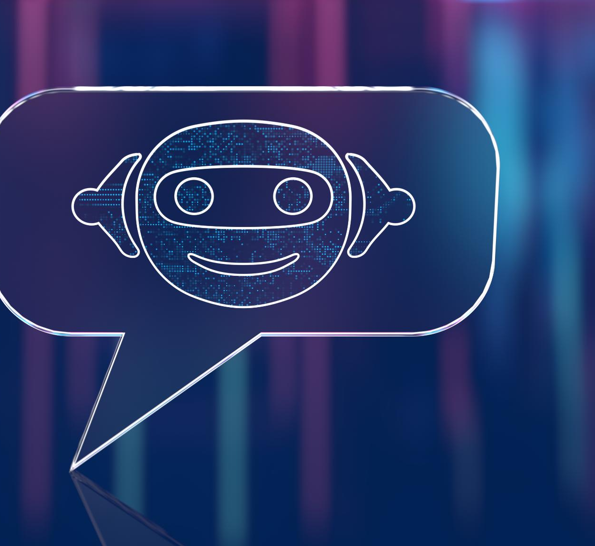
Creating Intents and Entities
Defining Precise Intents
Accurate intent definition helps systems understand user goals and respond effectively.
Extracting Accurate Entities
Entity extraction enables systems to identify key information from user requests for precise responses.
Notes:
--- Defining precise intents and extracting accurate entities are critical for understanding user requests and delivering appropriate responses. Image source: Microsoft 365 content library

Slide 13
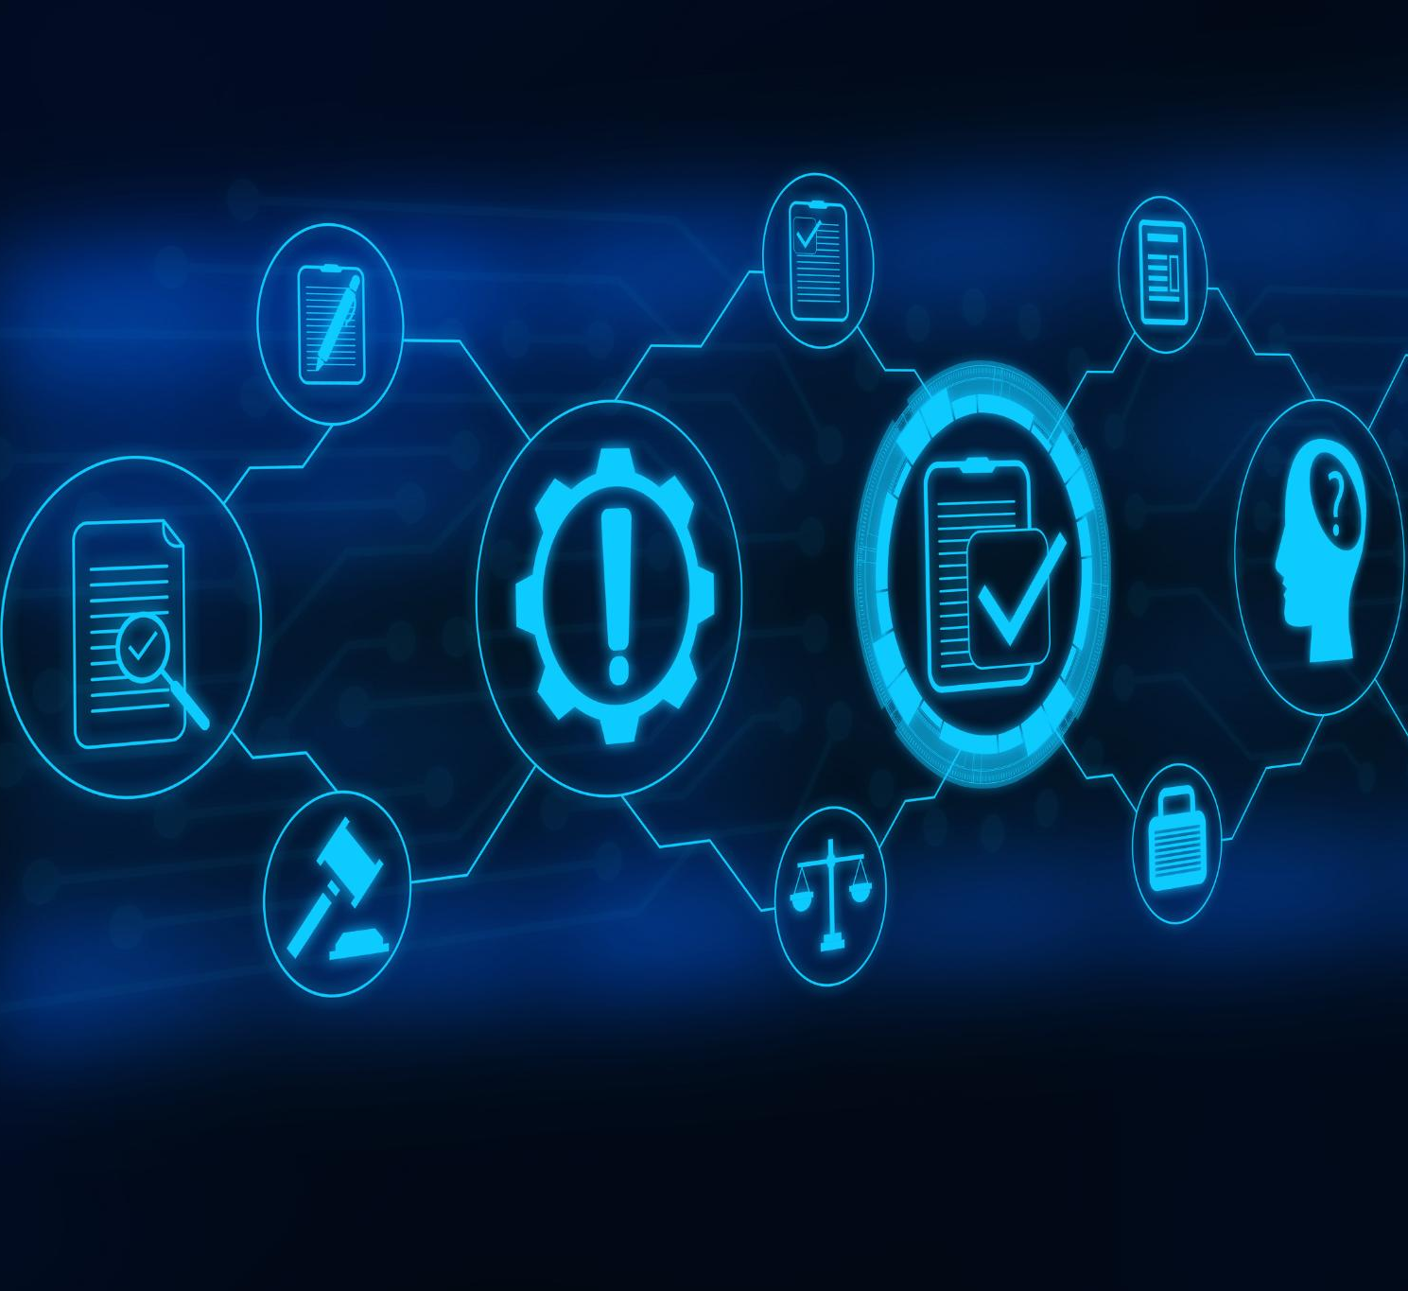
Debugging and Testing the Chatbot
Unit Testing
Unit tests check individual components to ensure each part functions correctly in isolation.
Integration Testing
Integration tests verify the interaction between different components works seamlessly together.
User Acceptance Testing
User acceptance testing confirms the chatbot meets user expectations and works in real-world scenarios.
Notes:
--- Testing includes unit tests, integration tests, and user acceptance testing to identify and fix issues before deployment. Image source: Microsoft 365 content library

Slide 14

Deploying to Azure and Other Channels
Publishing on Azure
Deploying bots on Azure ensures scalable and secure cloud hosting for wide accessibility.
Channel Configuration
Configuring communication channels like Teams, Skype, and web chat enables multi-platform user interaction.
Wide Accessibility
Publishing across multiple channels increases bot reach and user engagement in diverse environments.
Notes:
--- Deployment strategies involve publishing the bot on Azure, configuring channels like Microsoft Teams, Skype, or web chat, making it widely accessible. Image source: Microsoft 365 content library

Slide 15

Monitoring Bot Performance and Analytics
Usage Tracking
Monitoring bot usage helps understand how frequently and intensively the bot is used by users over time.
User Engagement
Tracking user engagement measures interaction quality and identifies areas to enhance user experience.
Error Monitoring
Detecting and analyzing errors ensures timely troubleshooting and improves bot reliability.
Insight Gathering
Collecting insights from analytics informs continuous improvements and strategic bot development.
Notes:
--- Continuous monitoring uses analytics dashboards to track usage, user engagement, errors, and to gather insights for ongoing improvements. Image source: Microsoft 365 content library

Slide 16
Conclusion
Powerful Tools Combination
Using Microsoft BotFramework and CLU combines robust tools for building intelligent chatbots.
Best Practices in Development
Applying best practices in design, integration, and deployment ensures effective conversational agents.
Enhanced User Experience
Well-built chatbots enhance user experience through natural and effective conversation.
Notes:
Building an intelligent chatbot using Microsoft BotFramework and CLU combines powerful tools and thoughtful design. Following best practices in development, integration, and deployment leads to effective conversational agents that enhance user experience.

